Slide 1
2014
Non- Aircraft Specific
REV 0
Day 2

Slide 2
AGENDA
1 – Navigation Deviations
2 – Altitude Deviations
3 – Runway Incursions / Surface Incidents
4 – Visual Departures and Arrivals

Slide 3
NAVIGATION DEVIATIONS
2014 Recurrent
Notes:
Primary Course Objectives:
Crews will be able to recite the top 2 causes of Nav. deviations as per NJA NAV Deviation Letter:
Incorrect route programming = 44%
Misunderstood clearances = 22%
Improper execution of correctly planned route = 16%
Improper application of automation = 13%
Misunderstood procedures = 4%
Crews will be able to accurately describe the steps and each crewmembers responsibility when conducting the FMS verification procedure policy IAW FOM or AOM requirements.
Crews will identify techniques used to mitigate errors associated with clearance recording and clearance misunderstandings as experienced when logging pre-departure clearance with ATC.

Slide 4
Section Overview
Navigation Deviation Trends
Mitigation Techniques
Pre-Departure Clearances (PDC’s)
FMS Programming

Slide 5
Navigation Deviation Trends

Slide 6
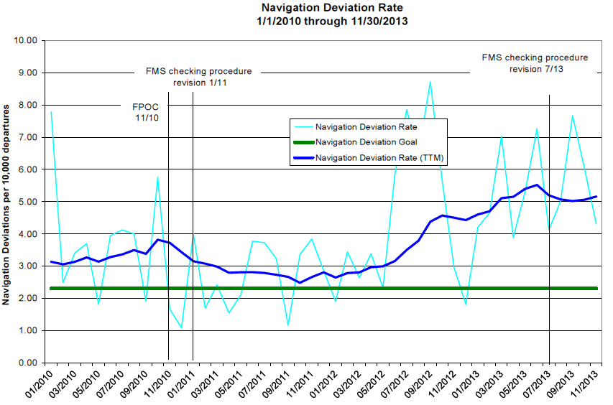
navigation DEVIATION Trends
Previously the trend for Navigation Deviations was showing a decrease.
Navigation Deviation rates are now showing a trend that has rapidly increased.

Slide 7
navigation DEVIATIONS Trends
When are they happening?
The primary causes of Navigation Deviations occur during the Pre-Departure Phase!
Notes:
This slide doesn’t make sense to me. Maybe I would understand it after hearing the commentary that will be used by the instructor.

Slide 8
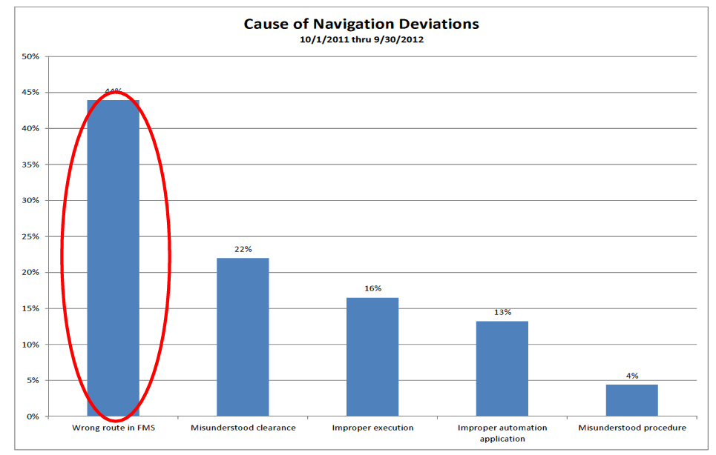


navigation DEVIATIONS Trends
These are the most often cited causes identified by the Crew Nav. Deviation Letter
Todays discussion will focus on these areas

Slide 9
Mitigating techniques

Slide 10
Mitigating techniques
Use the following flight scenario to discuss the barriers used to avoid Navigation Deviations

Slide 11
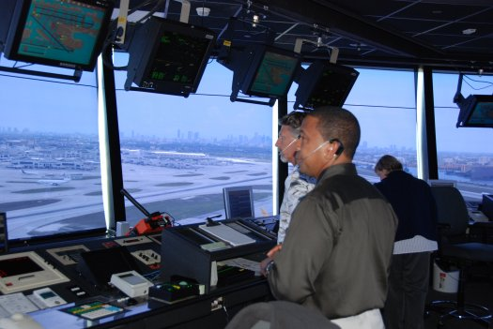
PIC is inside FBO making the fuel order and SIC is in aircraft preparing for flight with printed release
Upon calling for clearance, ATC responds:
Route:
KMMU - KIAD
Flight planned route:
KMMU BWZ J6 LRP HYPER.HYPER4 KIAD
“EXECJET 700, cleared to Washington Dulles via the Morristown 6, Solberg, J75 MODENA, HYPER 4 ARRIVAL KIAD, climb and maintain 3000’, expect FL 210 10 minutes after departure, squawk 4556.”
WX:
02007 6SM OVC 012 18/10 A29.98
Notes:
Instructor Notes:
Allow crews to read the slide prior to advancing. The intent is for the scenario to build a context.
This slide provides the beginning of a series of slides with questions referring to reducing threats associated with FMS programming. Show the crews that the route is not “as filed”
The takeoff runway, filed clearance and reroute provide an example of how a change to your clearance will make more work

Slide 12
Recording Clearance
Block Out
Enroute
Route:
KMMU - KIAD
What can the SIC use to help avoid a Nav Deviation when preparing the clearance and FMS for this flight?
Flight planned route:
KMMU BWZ J6 LRP HYPER.HYPER4
Write Clearance in a legible manner so other crewmember can read it
Use a complete and thorough read back in unambiguous terms to ATC making sure to clarify if needed
Load FMS immediately after receiving clearance
Plot course in iPad and compare to MFD (except class 3)
WX:
02007 6SM OVC 012 18/10 A29.98
Continued..

Slide 13
Recording Clearance
Block Out
Enroute
Route:
KMMU - KIAD
What can the SIC use to help avoid a Nav Deviation when preparing the clearance and FMS for this flight?
Flight planned route:
KMMU BWZ J6 LRP HYPER.HYPER4
Do not allow yourself to be rushed!
Attempt to have the other pilot handle duties while you are programming the FMS.
  (e.g. Have the other pilot handle the coffee/ice/papers and catering until you have completed.)
?
WX:
02007 6SM OVC 012 18/10 A29.98
Notes:
Instructor Notes:
Two bullets have been provided for answers to “barrier to threat of nav deviation” . Instructor should have a third if class does not provide an answer.

Slide 14
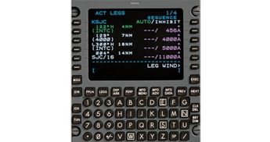
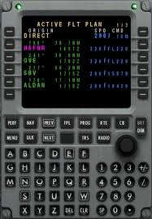
Recording Clearance
Block Out
Enroute
Route:
KMMU - KIAD
A prominent threat when recording clearances occurs when downloading or reading a PDC clearance.
Flight planned route:
KMMU BWZ J6 LRP HYPER.HYPER4
WX:
02007 6SM OVC 012 18/10 A29.98

Slide 15
PDC Clearances

Slide 16
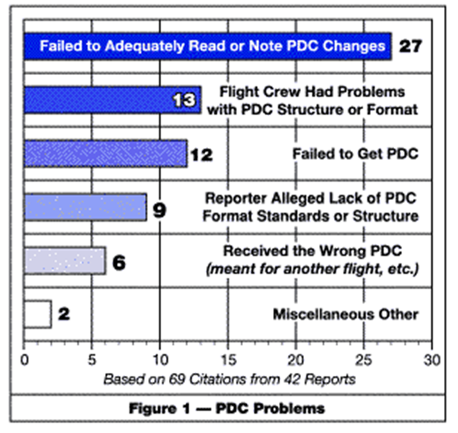
PRE-DEPARTURE CLEARANCES
Recording Clearance
Block Out
Enroute
NASA ASRS Analysis
42 reports that described problems with PDC’s
Notes:
ASRS Analysis “Callback” Issue 352 – April 2009

Slide 17
PRE-DEPARTURE CLEARANCES
Recording Clearance
Block Out
Enroute
Some errors associated with Digital PDC’s include:
Receiving the wrong leg-
  "Our flight (BOS-PWM) received the wrong departure (PDC) clearance in BOS. It had the proper flight number and date, but was the PDC for the ATL-BOS leg. When transponder code was reported wrongly off the PDC, they only said, 'change squawk to read xxxx,' thus not alerting the crew to the error. After takeoff, crew found out altitude cleared to was wrong also, but did not violate any altitudes. Coordinated with...ATC, company flight control and...operations to find error causes and correct."
Notes:
Referenced by ACN (179596)
This seems like a pretty gross error that certainly should have been caught by pilots. Do we have one with a more subtle “gotcha” that would really drive home the need for attention to detail?

Slide 18
PRE-DEPARTURE CLEARANCES
Recording Clearance
Block Out
Enroute
Some errors associated with Digital PDC’s include:
Failure to discover changes in filed route-
Route changes can often be difficult to find and may be hidden at end of PDC
Failure to activate SID/STAR in digital PDC route
PDC’s can contain confusing formats-
For example,
The symbol for direct is “..”
The symbol for “as filed” is “./.”

Slide 19
Recording Clearance
Block Out
Enroute
PIC has returned and both pilots are sitting in the cockpit prior to starting the engines.
What can the SIC use to help avoid a Nav Deviation at this stage of the flight?
Ensure FMS Programming completed
Use the Pre-Departure Safety Brief / Departure Briefing to verify the clearance runway, route, and departure.
Ensure recorded clearance is legible and understood by both crewmembers.
Any unusual portion of the clearance should be covered in detail by both crewmembers to prevent confusion.

Slide 20
Recording Clearance
Block Out
Enroute
Location: Enroute
ATC delivers a re-route
What can the SIC use to help avoid a Nav Deviation at this stage of the flight?
PM records new route as assigned, then PF reviews prior to PM entering route into FMS.
Verify new route in iPad to ensure nothing has been misunderstood.
After PM enters route into FMS, PIC reviews briefly prior to execution.
CAMI!
?
Notes:
Instructor Notes:
Four bullets have been provided for answers to “barriers to threat of Nav Deviation” . Instructor should have another one if class does not provide any input.

Slide 21
FMS Programming

Slide 22
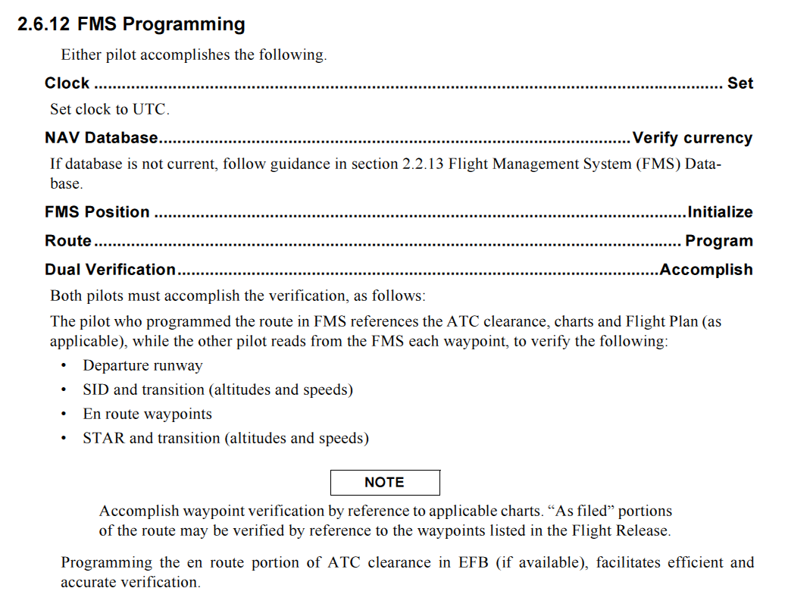
FMS Programming

Slide 23
FMS Programming
 | Pilot that loaded FMS | Pilot that was inside
1
2
3


€
€

€
€

€
€
1. Who is required to be present for FMS verification?
2. Who must read the flight plan out loud from the FMS?
3. Who must confirm the waypoints on the flight release?
4. What will you do if the clearance is not “as filed”?
Verify programmed route against charts
Notes:
Provide a review of the details of the FMS verification policy. Be sure to include:
Questions posed on this slide
Discussion of iPad use when preparing navigation references for flight
Technique for verifying SIDs and STARs when other than “as filed” is assigned.
Use this to facilitate a role play with two crewmembers in the audience.

Slide 24
TAKEAWAYS
The recent increase in Navigation Deviations should renew crewmembers resolve in identifying threats when handling clearances
Understand your PDC, if there is any confusion query ATC
Follow the guidance of the AOM or FOM in handling FMS programming procedures

Slide 25
AGENDA
1 – Navigation Deviations
2 – Altitude Deviations
3 – Runway Incursions / Surface Incidents
4 – Visual Departures and Arrivals

Slide 26
Altitude Deviations
2014 PC Cycle
Notes:
Primary Objectives of this course include:
Crews will identify the trend increase for altitude deviations and identify Altitude Deviations as one of the top three threats to operational safety.
Crews will use the method discussed by safety to determine descent planning for an example clearance provided by the instructor in a scenario requiring a crossing restriction after programming the restriction in the FMS. (See ASAP Newsletter VOL 7, issue 2)
Crews will describe the use of CAMI to verify the descent restriction will be made as programmed in FMS.
Crewmembers will be able to list the top 3 reported causes of altitude deviations per ASAP Newsletter (Need to gather this from newsletter and safety)
Crews can identify that 70% of altitude deviations are a result of a breakdown in pilot controller communication. (FlightSafety Foundation ALAR, 2000)
When provided an opportunity by the classroom facilitator, crews can identify four recommendations to improve pilot-controller communications. (ALAR,2000):
Be aware that readback/hearback errors involve both the pilot and controller
Use standard Phraseology (Where is this listed?)
Use expanded phraseology (Provide examples)
d. Request clarification if ever in doubt

Slide 27
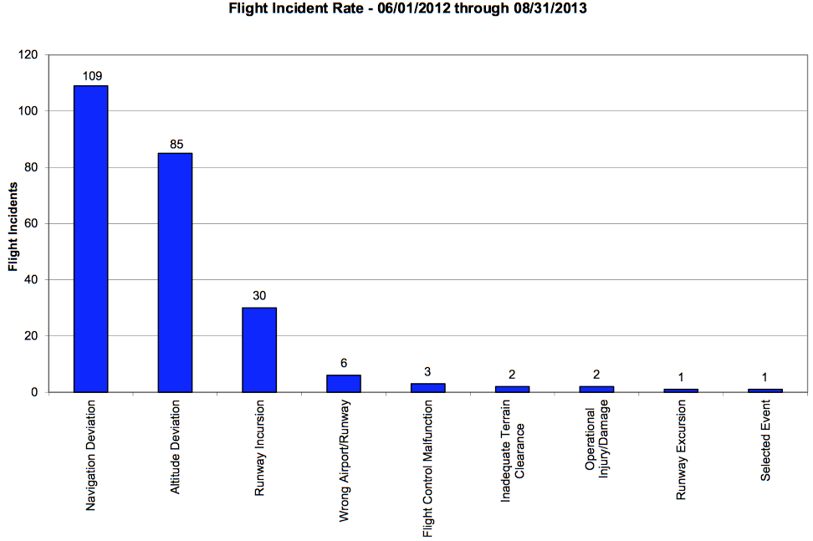
Altitude Deviations
2014 PC cycle
Rate second only to Navigation Deviations at NJ
Primary Risk-
Can result in a lack of aircraft separation
Notes:
Stress that while emphasis has been placed on Nav. Deviations recently, Altitude Deviations come in a close second.

Slide 28
Leading Cause?
70% attributable to Pilot/Controller communications breakdown
How have you experienced a Pilot / Controller communication breakdown?
Notes:
Studies by a number of organizations (FlightSafety Foundation ALAR, 2000) attribute the vast majority of altitude deviations to communications breakdowns.
Here’s a good opportunity to involve the class. Ask for examples where pilot/controller communications breakdowns can or have caused altitude deviations, either from their personal experience or suppositions. To spur the discussion, some examples would include:
1. Non-standard or foreign phraseology
2. Procedural differences, such as expectations on SIDS/STARS with respect to crossing altitudes
3. Confusion over call signs
After each point is raised, make sure to discuss steps that were/should have been taken to mitigate the problem. It is important to provide the crew with solutions

Slide 29
Where?
50% take place below 8,000 feet
Typically on a SID or STAR
Notes:
A study in Europe indicated that about half of controller detected altitude deviations occur below 8,000’. These are certainly, potentially, the most “dangerous” because of the concentration of traffic.
Discuss the various ways an aircraft could be at the “wrong” altitude on a SID or STAR. Again, make sure a discussion follows each item with a means of prevention/resolution. Examples include:
Example situations:
Misunderstood clearances
Inadequate review of arrival / departure chart
NJA focus area: RNAV Visual Arrival into KLAS. “Cleared for the RNAV Visual” vs. “Cleared for the Visual” terminology still confuses people. See KLAS 19-7 and 19-7A.

Slide 30

Operational and Human Factors
Altitude deviations are the result of a breakdown in at least one of the following:
Pilot/Aircraft interface
Pilot/Controller interface
PF/PM interface
Notes:
Pilot/Aircraft Interface refers to how the pilot interacts with the automation in the aircraft. Discussion points involve:
Over reliance on the automation
Failure to take command of the aircraft when the automation is not properly executing
Failure to recognize when the automation is not properly executing (this is different than the above item)
Inability of the crew to properly program the automation
Loss of SA by the crew
Pilot/Controller Interface refers to communications breakdowns between the crew and the ground. This was discussed in slide #3, but can be revisited to for emphasis. The major teaching point here is make sure, if the crew is in doubt, they absolutely need to resolve the ambiguity.
Finally, how the crew interacts with each other is important. Are they following SOPs? Are the proper roles being followed, or is the PF performing actions the PM should be doing or vice versa?

Slide 31
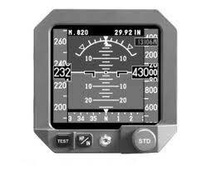
Pilot/Aircraft Interface
Not setting or improperly setting the altimeter prior to departure
Poor altimeter management at the:
  Transition Altitude
  Transition Level
1. Altimeter setting
Notes:
We’ve been setting altimeters since our first instructional flight – but we don’t always get it right.
The simple act of mis-setting the altimeter is the root cause of many altitude deviations.
Important teaching points:
Make sure the altimeters are set prior to departure – and that they are all set the same (except in a QFE environment where the STBY is set to QNH).
Reset the altimeters at the appropriate Transition Alt, Transition Level. Anticipate the change so no overshoots occur and remember that not all transitions occur at 18,000!

Slide 32
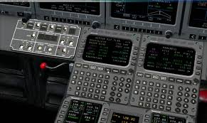
Pilot/Aircraft Interface
2. Automation
Improper programming of the FMS
Failure to monitor the aircraft’s path
Getting behind in programming changes
Notes:
Here’s a good opportunity to stress that sometimes it’s just better to disconnect the automation and fly the airplane. When the automation is not performing properly, don’t waste too much time trying to “fix” it. Just fly the airplane like a pilot!

Slide 33
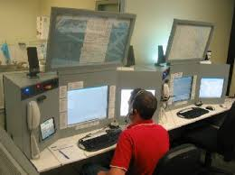
Pilot/Controller Interface
1. Clearance confusion
Read back/Hear back errors
  Applies equally to pilots and controllers
Blocked transmissions
Call sign confusion
Notes:
Sometimes we hear what we expected to hear, instead of what was actually said.
Discuss that point and that it applies equally well to pilots and controllers.

Slide 34
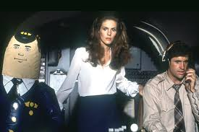
Pilot/Controller Interface
2. Communication loop
Phraseology
  e.g. Use full call sign
Failure to resolve ambiguity
Failure to ask for confirmation
Notes:
This is a good follow on to the previous slide.
If the phraseology doesn’t seem to make sense, ask for clarification. Particularly when operating internationally.
If the clearance doesn’t seem to make sense, ask for clarification.
The point to underscore is to make sure the crews resolve the ambiguity. Don’t guess.

Slide 35
PF/PM Interface
1. Task sharing
Overloaded crewmember
Tasks completed by “wrong” (as per SOPs) crewmember
Notes:
Self explanatory.

Slide 36
PF/PM Interface
2. Crew interaction
Missed call outs
Failure to cross check
Failure to provide support to an overloaded crewmember
Failure of SOP required pointing during altitude awareness procedure

Slide 37
ATC Causal Factors
Factor | % of Events
Late or revised clearance | 50%
Complex clearance | 20%
Vectoring on/off DP/STAR | 15%
Poor coordination between ATC units | 10%
Source: UK CAA/Eurocontrol 2004 Study
Notes:
These are factors that are under ATC’s control that can create an environment for altitude deviations to occur.
Remind the crews that clearances are not messages from above. They can be refused. In the event of a complex clearance change just prior to departure – don’t depart until you know, for certain, what’s expected.
If being vectored off and then back onto a SID or STAR, make sure you clarify future altitudes.

Slide 38
Prevention Strategies
Strict adherence to SOPs
Respect the defined roles of the PF and PM
Adhere to the sterile cockpit rule
Thorough briefs
Identify threats
Notes:
Discuss why this is important. This is another good opportunity to get input from the class. Act as a facilitator here – get crew members to bring up instances where failure to adhere to the SOPs led to problems. How did they resolve the issues?
Discuss the recent FOM revision concerning the sterile cockpit during climbs or descents within 1000’ of level off altitude.

Slide 39
Prevention Strategies
Apply good CRM
Mutual cross check
Watch for task saturation in the other crew member
Verbalize actions when they diverge from SOPs
Notes:
Another great area for facilitation. As the crews how they can detect task saturation in the other crew member (most common, they get quiet). How can they help?
This is an important area for discussion, so spend as much time on this slide as needed.

Slide 40
Prevention Strategies
Pilot/Controller Communications
Both pilots should be listening to ATC, whenever possible
Use standard phraseology
Resolve ambiguities
Be cautious of “hearing expectancy”

Slide 41
Prevention Strategies
CAMI
Confirm
  Altitude is set
Activate
  VNAV or other vertical mode
Monitor
  Confirm aircraft is following desired path
Intervene
  If it’s not working, fix it
  Speed brakes?
  Advise ATC?
Notes:
The most important points on this slide are the last two. Monitor the aircraft’s track and path – and intervene if necessary. Intervention might simply mean deploying speed brakes, but it could also mean taking manual control. Finally, if things aren’t working out, advise ATC as soon as possible so they can issue a new clearance.

Slide 42
Scenarios and Exercises
Notes:
The slides that follow offer a few scenarios to discuss.

Slide 43
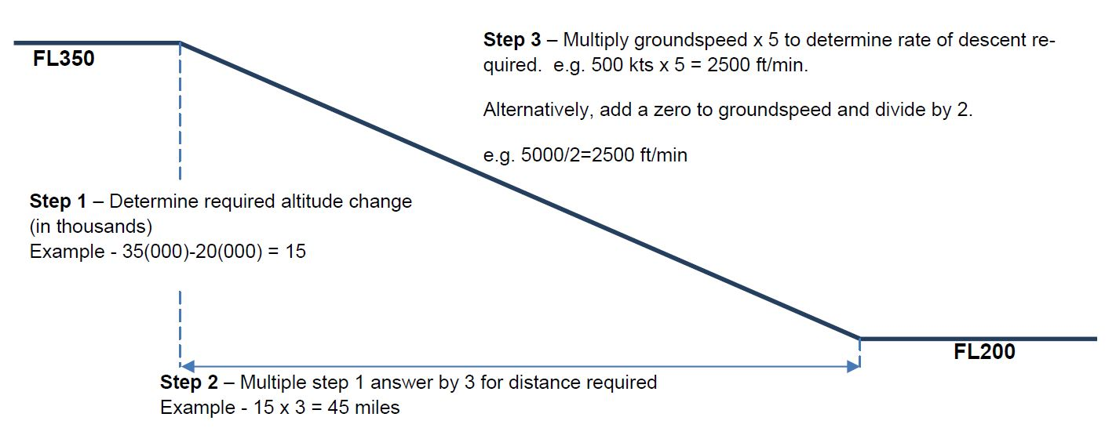
Descent Planning
Checking the FMS Programming
Verification of “reasonable TOD” of FMS computed descent is required per Chapter 5 of AOM or Fleet VNAV/NON VNAV Document
Source: ASAP Newsletter Vol 7, Issue 2
Notes:
This procedure was sourced from our ASAP Newsletter, as referenced on the bottom of the slide.
Provided is a method to determine the rate of descent to achieve a specified restriction in order to verify TOD. It can be used in isolation or as a means of checking the FMS.
Discuss the example given and then, time permitting, let the class perform a few examples of your choosing.

Slide 44
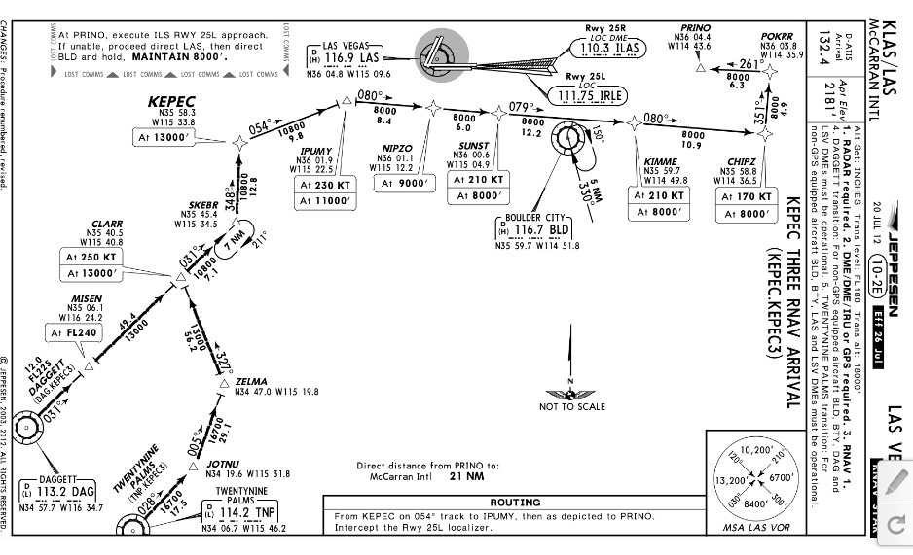
At IPUMY: “Descend and maintain 8,000.”
ICAO vs. US flight regulations?
Notes:
Question the appropriate descent upon receiving this clearance for both the US rules as well as the ICAO rules.
- For further supporting information consult FAA InFO 12003 -
The US does not follow ICAO guidance for descending on a STAR. This clearance would permit the crew to make an immediate descent to 8,000’, ignoring the 9,000’ restriction at NEPSO. Would this be true if this procedure was found in an ICAO compliant country? No.

Slide 45
At MISEN: “Descend via the KEPEC 3 Arrival.”
Notes:
This clearance means you are cleared to the bottom of the SID and must observe all the altitude restrictions in between.

Slide 46
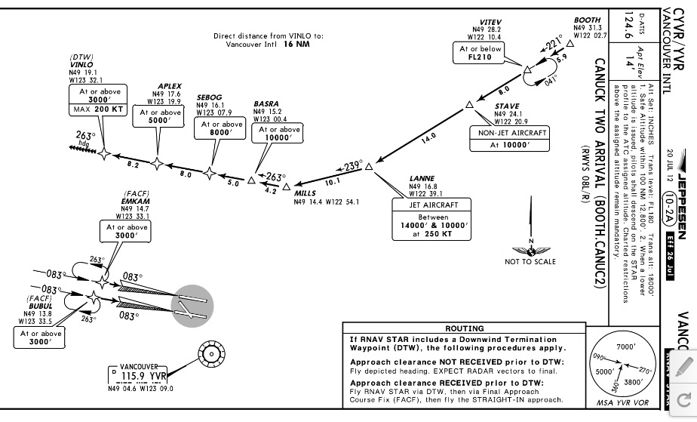
At STAVE: “Descend and maintain 3,000”.
Notes:
Since this is a Canadian procedure, and they do follow ICAO guidance in this regard, any altitude restrictions must be observed unless they are specifically eliminated.
Make sure the crews understand this critically important difference between ICAO compliant procedures and those in the US.

Slide 47
In Conclusion
Altitude Deviations are among the top three threats to NetJets Inc. operational safety
Pilot / Controller communication account for 70% of Altitude Deviations according to an industry study
Prevention strategies are available for us to help mitigate Human Factor oriented causes, many are related to policy and SOP adherence

Slide 48
AGENDA
1 – Navigation Deviations
2 – Altitude Deviations
3 – Runway Incursions / Surface Incidents
4 – Visual Departures and Arrivals

Slide 49
Runway Incursions
2014 LOS Cycle

Slide 50
Section Overview
Runway Incursions trends
Techniques to mitigate Runway Incursions
Airport Sign and Marking Review

Slide 51
Runway Incursion Trends

Slide 52
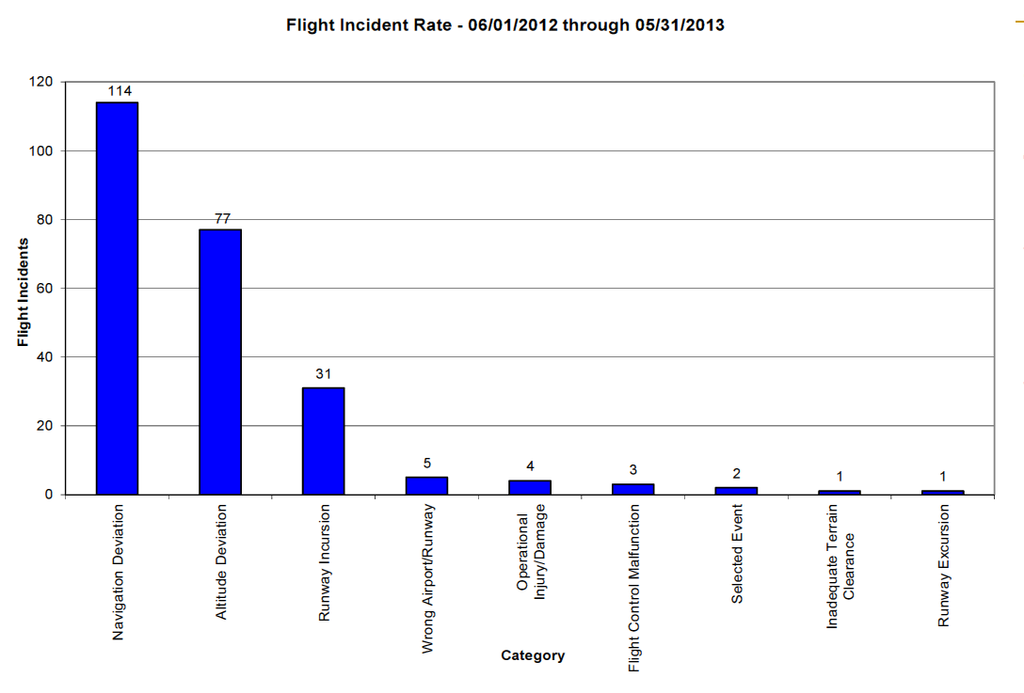


Runway Incursion Trends
Runway Incursions are the third highest of flight incidents

Slide 53

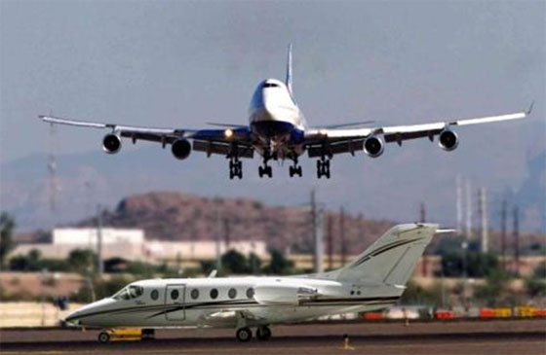
Runway Incursion Trends
An FAA investigation of industry runway incursions over past 10 years identifies three major contributing areas:
1) Failure to comply with ATC instructions
2) Lack of familiarity with airport
3) Non-conformance with SOP
Notes:
I’d like to see a bullet that said something like, non-standard hold line location(maybe as a subset of #2). -J

Slide 54
Mitigation techniques

Slide 55
Failure to comply with ATC instructions
Lack of familiarity with airport
Non-conformance with SOP

Slide 56
MITIGATION TECHNIQUES
Failure to comply with ATC instructions
This is a very broad category, here are a few aspects that have been identified as causes:
Expectation Bias
Exceeding professional pace
Miscommunication within the aircraft
Notes:
Please change #2 to simply rushing or hurrying. -Jay
Please define #3 -Jay

Slide 57
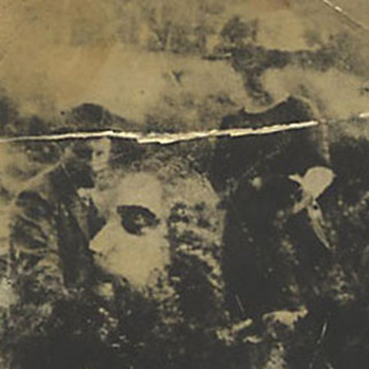
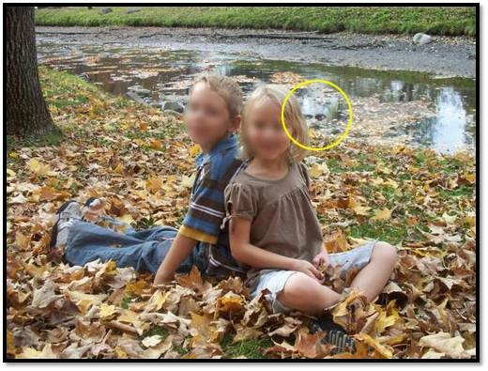
MITIGATION TECHNIQUES
The European Air Traffic Control (ATC) unit Eurocontrol defines
EXPECTATION BIAS as:
“Having a strong belief or mindset toward a particular outcome.”
Notes:
The picture provides an example of how our brains seek patterns and connections to create an expectation of what we are seeing against evidence otherwise.
This is an example of something that is not really there but our minds seek to make the pattern into something that we are familiar with. The faces in the pictures are really not faces, but the our mind takes the pattern and turns it into a face.
We do this when we receive a clearance and think they said something and it was actually something else. Maybe we have always gotten the same clearance in the past and today it was different, we did not really understand what was actually said.
Retrieved from (http://www.criticalthinkeracademy.com/3/post/2013/04/how-cognitive-biases-can-influence-science-pareidolia-expectation-effects-and-the-case-of-n-rays.html)
Definition and data retrieved from FAA website:
FAASTeam Notice
Type: General Information
Notice Date: Friday, September 28, 2012
Notice Number: NOTC4214
Pilot Safety Tip - Expectation Bias (http://www.faasafety.gov/SPANs/noticeView.aspx?nid=4214)

Slide 58
MITIGATION TECHNIQUES
Hearing what we expect to hear is frequently listed as a causal factor for pilot deviations that occur both on the ground and in the air.
Expectation Bias is one of the most common causal factors for pilot deviations.
  Data from the Air Traffic Safety Action Program confirms this fact.
Notes:
Definition and data retrieved from FAA website:
FAASTeam Notice
Type: General Information
Notice Date: Friday, September 28, 2012
Notice Number: NOTC4214
Pilot Safety Tip - Expectation Bias (http://www.faasafety.gov/SPANs/noticeView.aspx?nid=4214)

Slide 59
An Example of Expectation Bias and exceeding Professional Pace

Slide 60
MITIGATION TECHNIQUES
POINTS OF THOUGHT
Where did the controller expect LJ6 to cross?
What were the first indications of Expectation Bias?
Is it likely LJ6 was in a rush? Could Professional Pace be at risk?
When would you have slowed the pace of the flight deck, why?
Were the pilots of LJ6 solely at fault?
What were the indications that extra vigilance was required by all parties?

Slide 61
Failure to comply with ATC instructions
Lack of familiarity with airport
Non-conformance with SOP

Slide 62
MITIGATION TECHNIQUES
These two categories are very closely related
Here are a few suggestions:

Slide 63
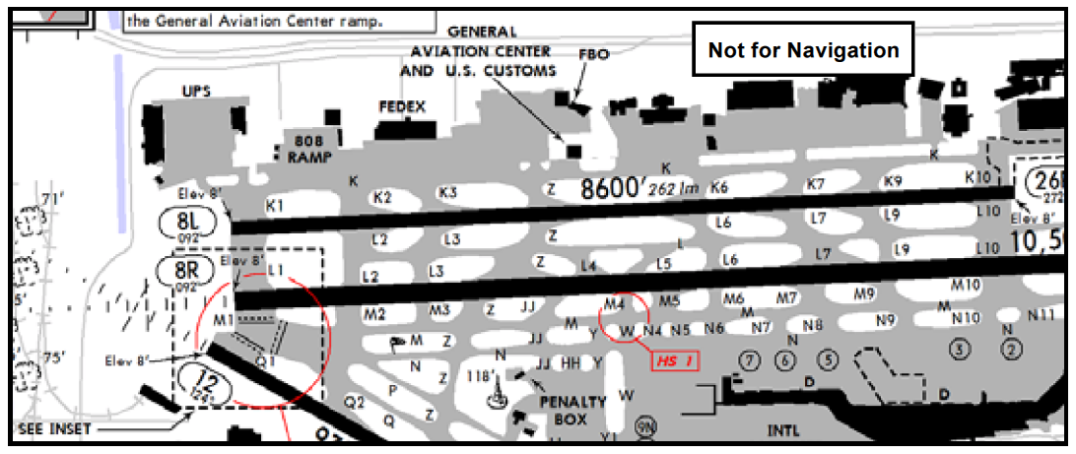
MITIGATION TECHNIQUES
Review the cleared or likely taxi route, including all “hotspots” and possible incursion points prior to taxi or during the approach briefing. (SOP)
Careful monitoring of the aircraft position during taxi by both crewmembers. In some cases, this will require the delay of checklist completion. (FOM)

Slide 64
MITIGATION TECHNIQUES
If any doubt exists regarding the aircraft position or Air Traffic Control (ATC) instructions, the aircraft should be stopped and clarification obtained immediately. (SOP)
Read back all “hold short” instructions issued by ATC. (FOM)
Understand the purpose and significance of all ground markings, signs and lighting…..

Slide 65
Airport Sign and Marking Review

Slide 66

Airport Sign and Marking Review
Denotes entrance to runway from a taxiway.
Also denotes intersection Runway.
MANDATORY: Hold position for Taxiway/runway Intersection

Slide 67

Airport Sign and Marking Review
Identifies taxiway on which the aircraft is located

Slide 68
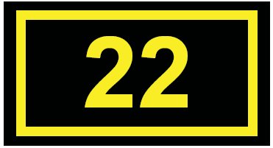
Airport Sign and Marking Review
Identifies Runway on which the aircraft is located
Normally located where the proximity of two runways to one another could cause confusion

Slide 69

Airport Sign and Marking Review
Runway Safety Area and Runway Approach Area Boundary
Identifies exit boundary for an RSA/OFZ
Located on taxiways and on backside of certain runway/taxiway holding position signs or runway approach area signs

Slide 70
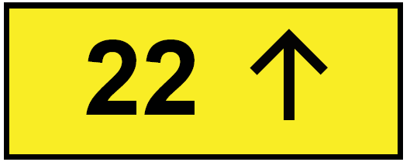
Airport Sign and Marking Review
Outbound destination marking - defines direction to take-off runway

Slide 71
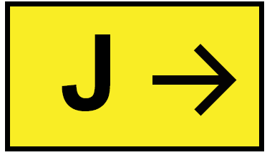
Airport Sign and Marking Review
Defines designation/direction of intersecting taxiways
Is this located before or after the taxiway it denotes?

Slide 72

Airport Sign and Marking Review
Denotes entrance to runway from a taxi
Located across centerline within 10 feet on hold sign on taxiways and on certain runways

Slide 73

Airport Sign and Marking Review
Denotes location on taxiway or apron where aircraft hold short of another taxiway

Slide 74

Airport Sign and Marking Review
Delineates movement area under control of
ATCT, from non-movement area. Located on to ensure wing clearance for taxiing aircraft.

Slide 75

Airport Sign and Marking Review
Defines edge of usable full strength taxiway

Slide 76

Airport Sign and Marking Review
Defines taxiway edge where adjoining pavement is usable

Slide 77
TAKEAWAYS
Runway Incursions are among the top 3 categories of incidences reported along with Navigation Deviations and Altitude Deviations
Factors to appreciate when avoiding runway incursions include:
  Expectation Bias
  Rushing
  Miscommunication
  Disregarding SOP
  Lack of familiarization with airport diagram

Slide 78
AGENDA
1 – Navigation Deviations
2 – Altitude Deviations
3 – Runway Incursions / Surface Incidents
4 – Visual Departures and Arrivals

Slide 79
Visual Arrivals
2014 PC Cycle
Notes:
Objectives:
1 - Crews will identify the area identified as having the highest occurrence of threats when performing visual approaches at destination airports per ASAP data.
2 – Crews will reference the FOM section covering the acceptance of visual approaches as well as the level of burden associated with accepting visual approach clearances. Crews will also apply the FOM rule set to an application question.
3 – Crews will identify at least 3 different sources of information available to mitigate threats associated with Visual Arrivals at controlled or uncontrolled airfields.

Slide 80
Overview
Responsibility shift when cancelling IFR
Example of incident in Wichita
How to mitigate the threats
Notes:
The pilots should walk away with an understanding of the VFR / VMC windows that they operate under IFR.
A few techniques are provided to assist the pilots in mitigating the threats that arise from the IFR to VFR situation
***please insert Wichita Incident info in crib notes. -J

Slide 81
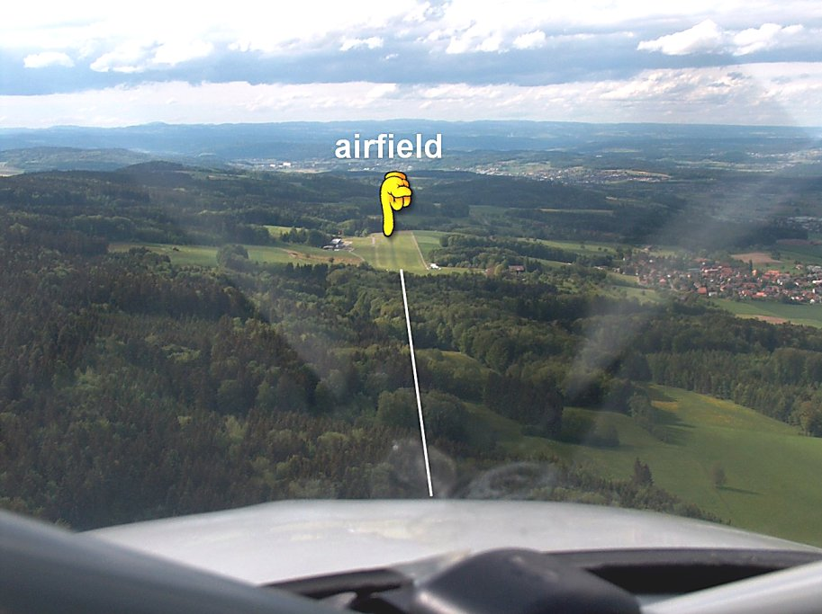
Statistically
ASAP data suggests that errors occur from 15 miles out until properly aligned with the CORRECT landing runway under VMC.
Why?
Notes:
The biggest difference between a field IFR and a field VFR is during IFR approaches there is one controlling agency. (Re-emphasis point) Once aircraft are cleared for the visual the pilots assume all traffic separation duties. One controlling agency vs multiple controlling agencies.
* Why?
* What is our culture in training vs. our culture in practice and line flying?
Facilitate this answer:
We have a culture of IFR Approaches in Publication and Training, but we have a culture of Visual approaches in practice, line flying.
Consider the FOM, SOP, etc.

Slide 82
Pilot responsibilities
“I think I see the airport at 1 o’clock. Lets just cancel IFR now”
Who now holds responsibility for airspace and traffic separation?
What are the responsibilities for the crew once on a visual approach?
Notes:
Help the pilots realize that when they are operating visually, all the responsibility is on them as shown previously. This includes obstacle and traffic awareness.
This shows the FOM reference concerning obstacle avoidance.
Night presents another risk factor which should be observed. The FOM does not recommend such a visual approach unless certain additional criteria are met. ***FOM 2.4.4 -Jay

Slide 83
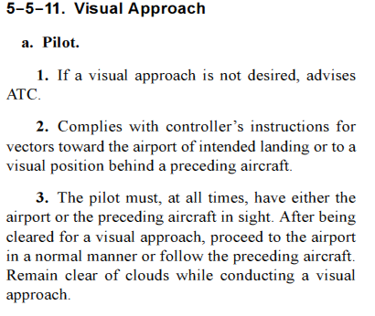
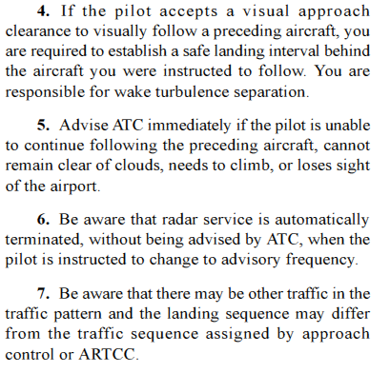
Pilot responsibilities
Notes:
The AIM excerpt (AIM 5-5-11) contains guidelines for pilots in reference to visual approaches as well as the pilot responsibilities when accepting them. Point out the lengthy list of responsibilities as well as the increased risk when accepting the visual approach clearance.
Time permitting:
Give them this reference and SHOW them where it is on their iPad
AIM 5-5-11, Visual Approach

Slide 84
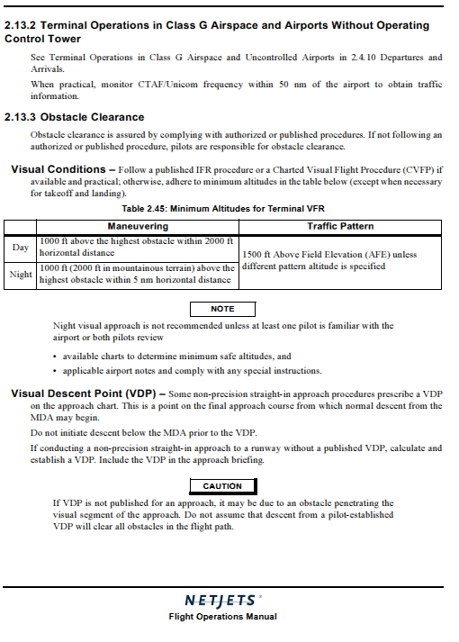
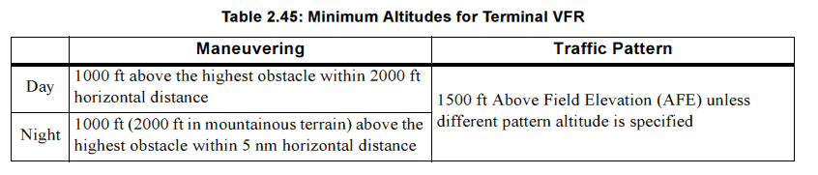
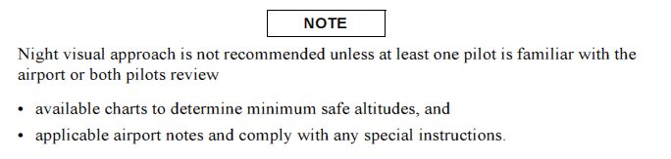
Pilot responsibilities
Notes:
Help the pilots realize that when they are operating visually, all the responsibility is on them as shown previously. This includes obstacle and traffic awareness.
This shows the FOM reference concerning obstacle avoidance.
Night presents another risk factor which should be observed. The FOM does not recommend such a visual approach unless certain additional criteria are met.

Slide 85
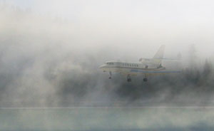
Pilot Responsibilities
During visual approaches, in addition to obstacle avoidance responsibilities weather requirements must be adhered to..
What weather requirements exist when accepting a visual approach into a class “E” airport when flying under Part 135?
Notes:
This question is intended to show how the application of the chart in the FOM can be complicated when accepting a visual approach.

Slide 86
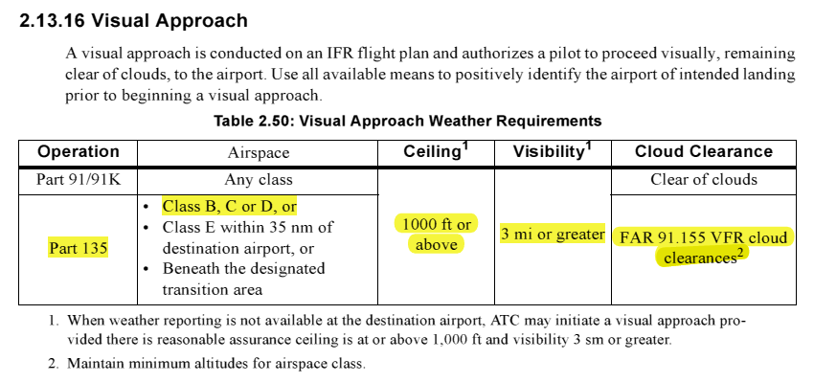
Cloud clearance is as required for class “E” in 91.155 (1000’ above, 500’ below, 2000’ horizontal), and the visibility is restricted to 3 miles or greater.
The FOM also requires a 1000’ ceiling
Notes:
Show how the variations between flying under part 135 and part 91/91K complicate the matters even more. Standard application of the cloud clearances of FAR 91.155 are not complete enough to meet the requirements of the FOM.
Another point which could be made includes a discussion on a 91K flight into a Class “E” airport with a visibility below 3 miles. When you accept a visual approach clearance, do the requirements of 91.155 still apply?
- No, a visual approach clearance is still an IFR clear
- This further complicates the matter.

Slide 87
Threat Identification
iPAD/ Terminal Charts/ Enroute Charts
Master Flight Document Package
AFD
Notes/ Feasibility
Sources to Identify Threats
Notes:
What information do you get from the terminal charts? (A) 10-9 Wildlife, gliders parachute jumpers, NON STANDARD TRAFFIC PATTERN
What information do you get from the en route charts? (A) NOTE: this is the big one: Similar airports nearby, airspace transitions, Class B, C, D, E.
A/FD? (A) NON STANDARD TRAFFIC PATTERN
Master Flight Document? (A) Company Identified Hazards
Brief Sheets / Feasibility????
*Let them know now, that we are going to show them how to use their tools, iPad specifically, to identify the threats they might encounter
*Also let them know now that we are going to show a number of examples of our pilots making these mistakes, through de-identified ASAP reports. (Will prevent the question, who would do that?)

Slide 88
Threat Identification
Lets review some examples of threats identified in past ASAP’s
Inadequate pre-departure safety brief
Traffic to follow misidentified
Wrong field identified visually
Wrong runway identified at large field
Inadequate approach briefing
Last minute changes to plan
Notes:
We will provide a few examples of some of these threats in the slides to follow.

Slide 89
PRE-DEPARTURE SAFETY BRIEF
“Looks Like it is VFR here… We’ll pick up our clearance in the air… destination is VFR so we will plan on the visual….”
Notes:
Objective: Pilots should be assessing their responsibilities and understanding the hazards associated with VMC flight
* Questions that can be used for discussion:
- What is your reaction to a briefing like this? (Probably normal)
- Are you more relaxed with VFR at your destination or IFR?
- Where do you think the errors usually occur, Large airfields served by an ILS reporting 200 OVC ½ Vis, or a small airfield clear with 10 miles vis?
Get the discussion going towards what the variables are… IFR is usually 1 or 2 possibilities, vs VFR much more latitude on HOW you get in for a landing.
* Questions that can be used for discussion:
- How many controlling agencies are on a field that is IFR? Answer 1.
- How many controlling agencies are on a field that is VFR? Answer – Variable – Once a pilot has accepted a visual approach the pilots assume all traffic and separation duties. They are all controlling agencies
*ASAP report:
“We departed KMMU prior to the Tower opening. Tried to call NY Departure on two different frequencies to pick up our IFR clearance on the ground prior to departing, with no result. We decided to depart VFR in VMC conditions to pick up our clearance in the air. We departed runway 5 on the Morristown 3 departure which states a heading of 160 and 2000’. After departure I immediately contacted NY departure but it took some time before we received a sqwauk code and the controller said we were in radar contact. At that time he stated that we had entered the Class B, and that we were 7 miles from Newark.”
* Thoughts?

Slide 90
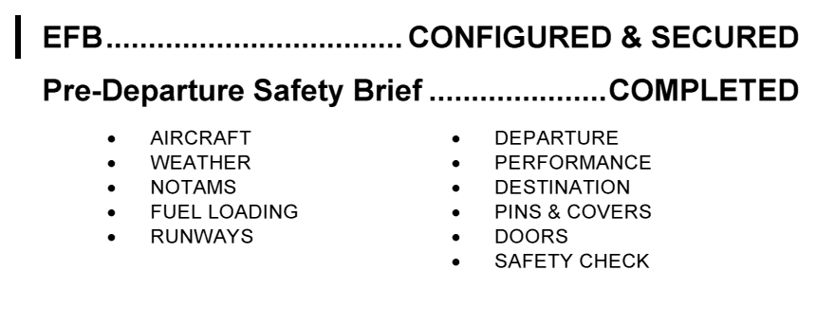
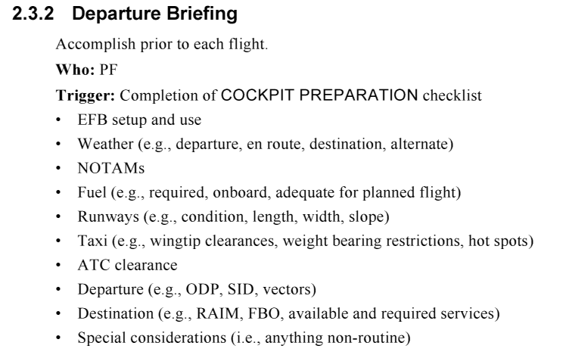
PRE-DEPARTURE SAFETY BRIEF / DEPARTURE BRIEFING
AOM Aircraft
FTSH Aircraft
Notes:
Facilitate a discussion on the role of the Pre Departure Safety brief –
- On a routine flight, do we discuss the threats that we might face during the flight, or just rote regurgitation of the numbers?
- More focus may be paid for a flight to ASE, SUN, TEX or some non normal airport.
- How do you usually use the Pre-Departure Safety Brief in relation to the arrival airport surrounding environment and airspace?

Slide 91
Many incidents reported seem to indicate that flight crews are overly optimistic regarding their ability to see and identify traffic, airports and runways, and often reply inappropriately to the query “do you have ________ in sight?”
Notes:
Ref: Visual Trap, NASA ASRS

Slide 92
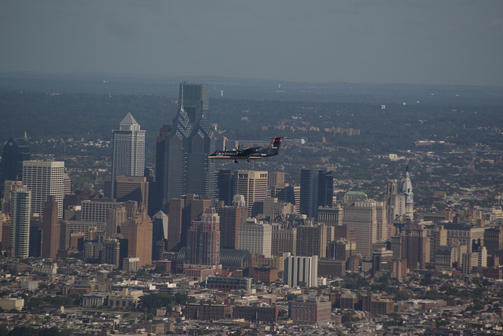
Call traffic in sight…
Notes:
Read the ASAP narrative:
“We were on a right downwind for landing at KSAN airport… ATC asked us if we saw the southwest aircraft at our 1:00 position in the traffic
pattern. We saw an aircraft which resembled a Southwest jet and assumed that we were looking at the
aircraft that ATC had specified.
My co-pilot and I looked to the 1:00 position from our aircraft and saw an aircraft which appeared to be a
737 in what seemed to be a slight right turn from base to final. From that
distance it is difficult to recognize aircraft paint scheme especially against such a densely populated
area, but we discussed with each other as to whether the aircraft in question was indeed
the Southwest Airlines jet at our 1:00 to which we both agreed it was. We were both satisfied that this
was the target that the Tower had pointed out to us so we notified ATC that we had said target in site,
and they subsequently cleared us to land behind that traffic.
We turned base shortly after our clearance to land was given, and began our decent to land keeping the
aircraft we had spotted in sight. A few moments later, ATC issued us an immediate left turn to 070
degrees (I think?) which was an approximate 110 degree left turn from our current heading (base leg).
As we turned to the left, we noticed a SECOND aircraft behind the airplane we were following, which
apparently, was the Southwest aircraft that ATC was originally talking about…” - ASAP

Slide 93
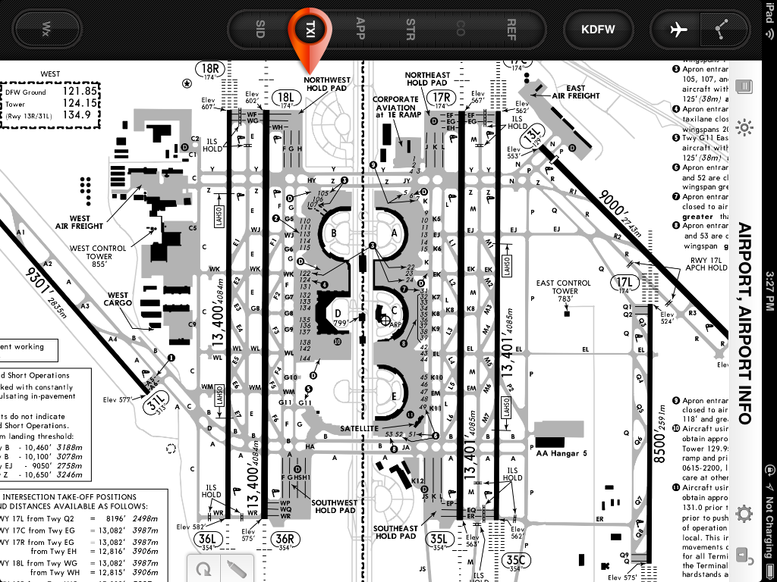
Wrong runway
If a crew briefs the visual to 36R on arrival, but is given the visual approach to runway 35C.
In the past, this has resulted in a runway overshot causing TA/RA
Notes:
Discuss the threats with a last minute runway change in visual conditions?
- High Traffic
- Multiple Runways that look similar (as shown on slide)
- Probably do not have instruments set up for the new runway

Slide 94
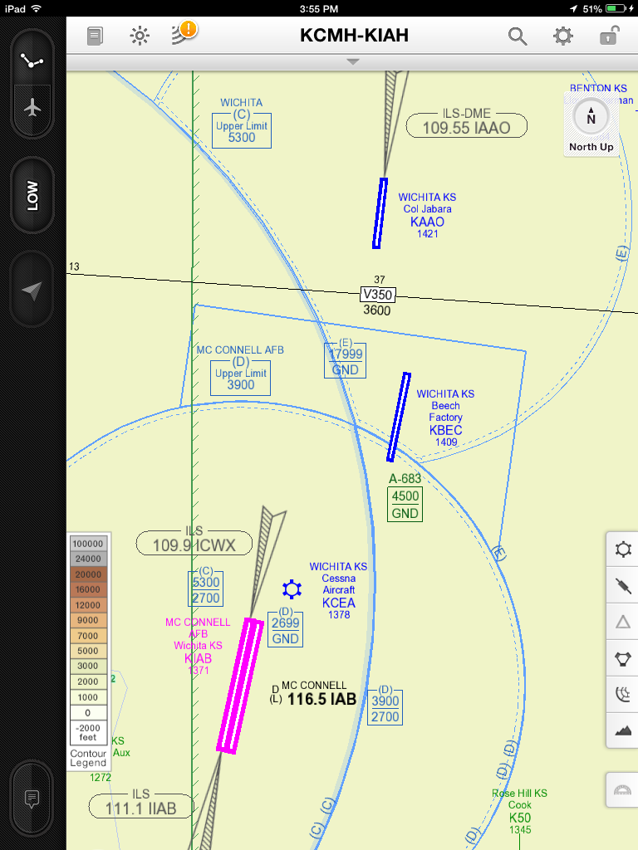
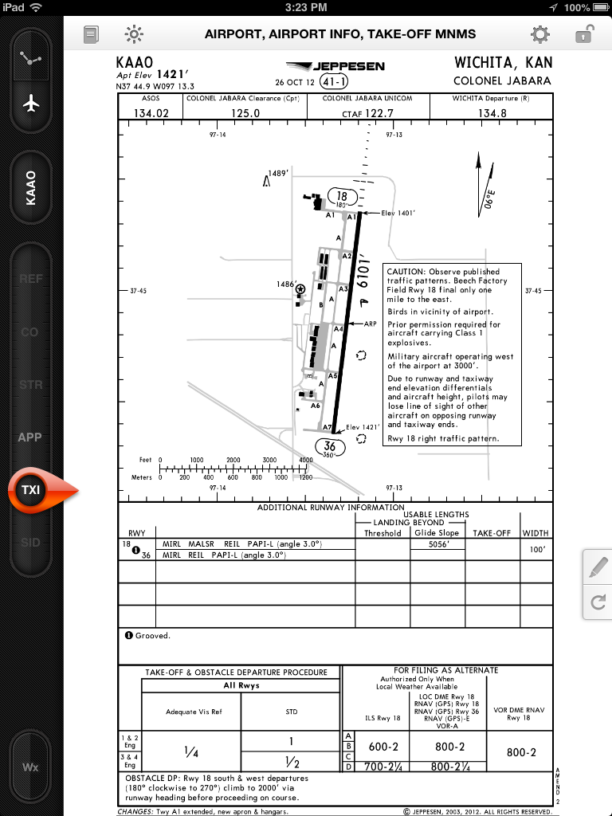
Similar Airports
Consider how difficult it could be to identify the proper airport when accepting a visual approach…..
Notes:
The ICT area has a few airports in close vicinity with runways that are closely aligned.
The next slide will provide another example of how building more situational awareness will help mitigate threats such as these.
*Note the same CTAF frequency after hours, and alert area hash marks surrounding the area. This is a multiple ASAP event: Confusing the airports in ICT.
*Tell the class to mentally note this area, so that when they are briefed to fly here, they can use caution

Slide 95
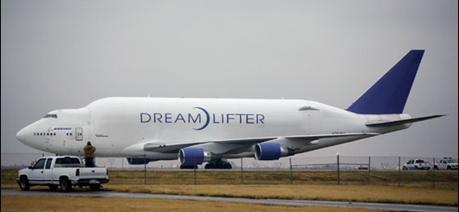
Similar Airports
McConnell Tower - “Giant 4241 Heavy, roger, you, it appears that you are at Jabara,”
Giant 4241 - “Uh, say again?”
Notes:
According to archived ATC recordings of the McConnell Air Force Base tower frequency on LiveATC.net, the pilot called the tower and reported the RNAV (GPS) RWY 19L approach. The tower instructed the two-pilot crew to verify the wheels were down, cleared them to land, and updated them with current wind conditions of 140 at 4 knots. The pilot repeated the landing clearance. About two minutes later, the tower told the crew to "check wheels down." The pilot caught the call sign and said, "Giant 4241 Heavy, go ahead." The controller repeated the advisory to check wheels down and told the crew to expect a turnoff at midfield at Taxiway Delta.
"Giant 14...4241 we might, we'll have to get back to you momentarily, we're not on your approach," the pilot said.
The controller replied, "Giant 4241 Heavy, McConnell is nine miles south of you."
"... We just landed at the other airport," the pilot said. The pilots said they thought they had landed at Beechcraft Factory Airport, an airport between Jabara and McConnell. Beechcraft has a single 8,001-foot-long runway, also 01/19, along with an RNAV (GPS) RWY 19 approach.
McConnell tower responded, “Heavy, verify that you’re on the ground at Beech Airport?”
“We think so,” the pilot confirmed. The crew later verified for McConnell tower that they were at Beechcraft airport, and the controller inquired if they would be able to take off and procede to McConnell.
"Ah, we're working on those details now, sir," the pilot responded. After four minutes, the crew asked for a frequency and coordinates for Beechcraft airport. Their current location coordinates didn't match those given by McConnell tower, which had asked if the crew circled over the airport or made a straight-in approach. The controller said that the target on the radar scope had shown the jet "overtop" Jabara; however, the pilots still were not certain at which airport they were located. In the meantime, men had started to approach outside the jet at Jabara and were communicating with the pilots.
The pilot then reported, “We just had a twin engine aircraft, a turboprop aircraft go over the top of us.”
“Giant 4241 Heavy, roger, you, it appears that you are at Jabara,” McConnell tower said.
“Uh, say again?”
The pilots later confirmed their location at Jabara and continued working with their company to determine whether the jet could depart.
FlightAware shows the jet departed John F. Kennedy International Airport at 7:26 p.m. Eastern Nov. 20, headed to McConnell Air Force Base. Atlas ground crew based in Wichita repositioned the jet overnight on Jabara’s runway, turning it 180-degrees to prepare it to depart on Runway 36.
FAA spokeswoman Elizabeth Cory told AOPA that the “FAA is investigating, which is standard.”

Slide 96
Threat and Error Management
FMS
Situational Awareness
Checklists
Correct Airport / Runway
ATC
Profiles
When we are vigilant
Approach Briefing
Notes:
96
Events can slip all the barriers we have in place to prevent landing at the wrong airport or runway. We have many tools available to help prevent this, such as briefings, use of IFR approaches to back up a visual, extended centerline in FMS, etc.

Slide 97
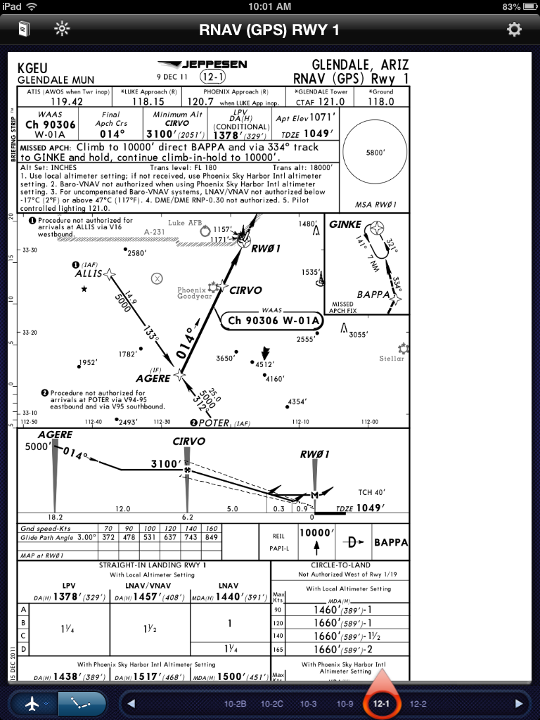
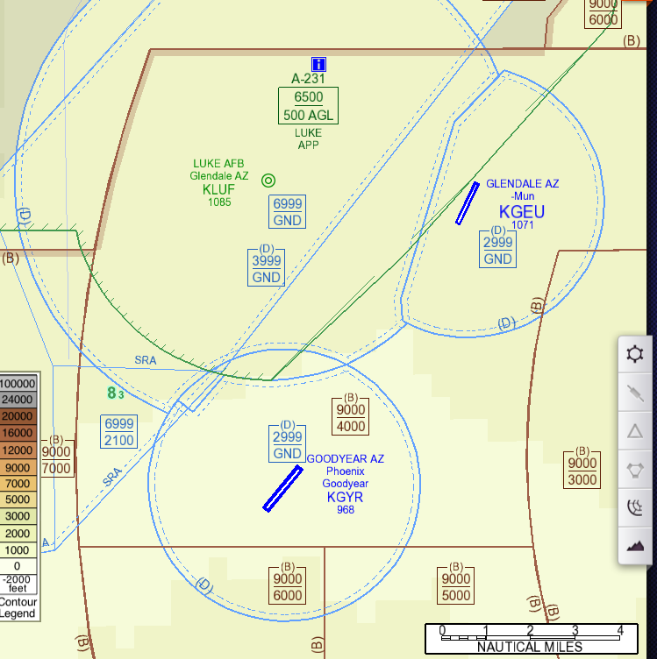
ATC LAST MINUTE INSTRUCTION
Notes:
OVERVIEW: Re-emphasize the iPad enroute chart setup. Identify the airspace. Read the narrative, then discuss how you could actually comply, at the last minute with the clearance to avoid the airspace over Goodyear.
*Read the ASAP narrative:
Captain: Maneuvering to land at GEU (Glendale AZ) in VMC conditions, we were under Luke AFB control. Over
BXK VOR Luke cleared us from 7000' to 4000'and
were told to fly HDG 110 degrees which put us on course to go
just South of GYR (Goodyear AZ) airport.
GEU was landing RWY 1 while GYR was landing
RWY 21, (not confirmed but given the TCAS traffic it appeared as though). Luke Airspace was active.
Luke ATC advised us of various VFR targets in the
pattern at GYR We were cleared for the visual to GEU and to remain outside of GYR airspace (3000' msl
and 3 nm radius). We crossed GYR airport at
approximately 4000' and intercepted a 3 degree glide-path into GEU. On the visual approach to GEU, we
descended following the RNAV GPS RWY 1 and
landed without incident. On the ground we were told to contact GYR Tower. We were told we penetrated
GYR airspace.
ASAP: First Officer :We did not pull out the VFR charts, and did not know the exact boundaries of the GYR Class D airspace. In the future I will review the VFR charts prior to descending into regions with similarly close airports.

Slide 98
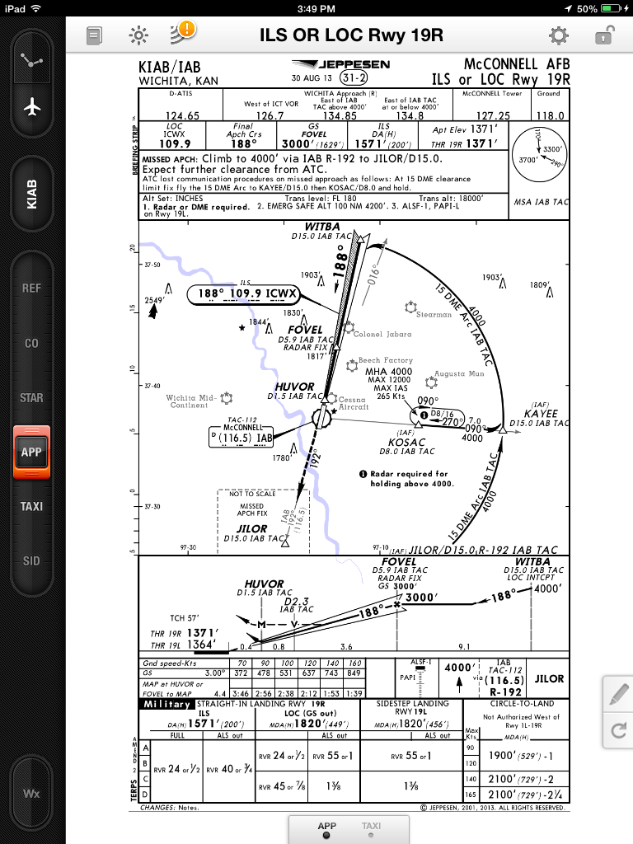
Approach Briefing
What details of the area may you include in your brief if you were landing here?
Notes:
3 other airports(Jabara, Beech, Cessna) do line up with McConnell. This would be a big threat during a visual approach, especially if not backed up with the ILS.

Slide 99
Summary
Identified threats and responsibilities for IFR to VMC operations
Discussed using the tools available for visual approach threat mitigation
Avoid accepting last minute ATC constraints to visual approaches unless you know you are able to comply with them.
Consider the threats which may not be so obvious when conducting visual approaches.

Slide 100
Questions?

