Slide 1

Certificated Flight Instructor
Single Engine Land Airplane
Adam Stoughton ATP, CFI-I, M.S.

Slide 2
What does Adam need to do?
I make sure you are:
1. Able to make a practical application of the fundamentals of instructing;
2. Competent to teach the subject matter, procedures, and maneuvers included in the standards to students with varying backgrounds and levels of experience and ability;
As per PTS
3. Able to perform the procedures and maneuvers included in the standards to at least the Commercial Pilot skill level while giving effective flight instruction; and
4. Competent to pass the required practical test for the issuance of the flight instructor certificate with the associated category and class ratings or the addition of a category and/or class rating to a flight instructor certificate

Slide 3

Here is our “Road Map”

Slide 4
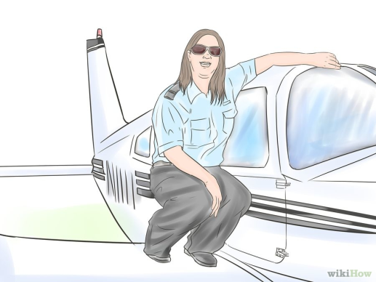
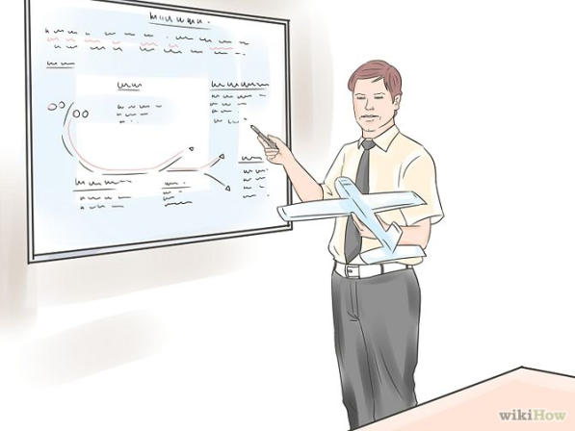
Course Elements
Fundamentals of Instructing (How to teach)
Technical Subject Areas (What to teach)
Right seat competency (Teach in the aircraft)
Instructor Duties and Responsibilities (What needs to be taught)

Slide 5
How to study and prepare
FOI
Read prior to class and discuss in class
Technical Subject Areas
Prepare lessons and teach to class
Right Seat
Flight Training with Instructor flying and teaching
Duties and Responsibilities
Discuss progressively

Slide 6
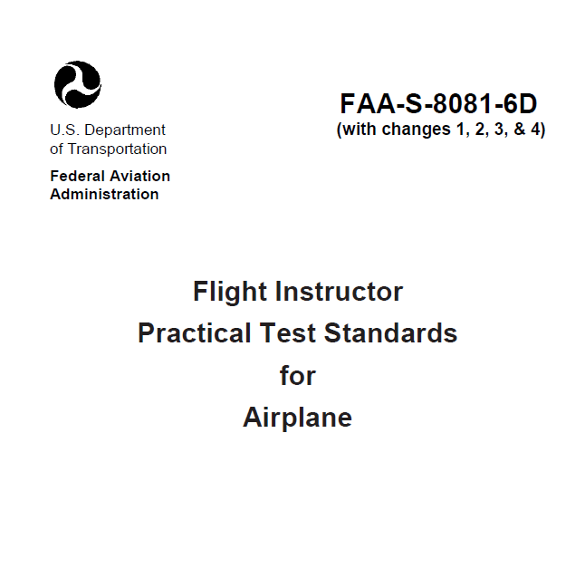
Standards

Slide 7
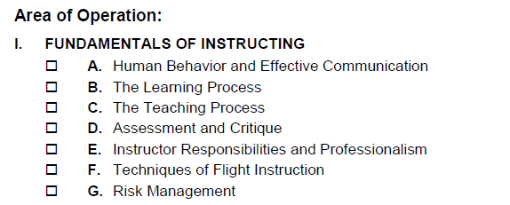
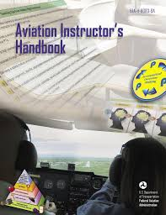
Guided Discussion Format

Slide 8
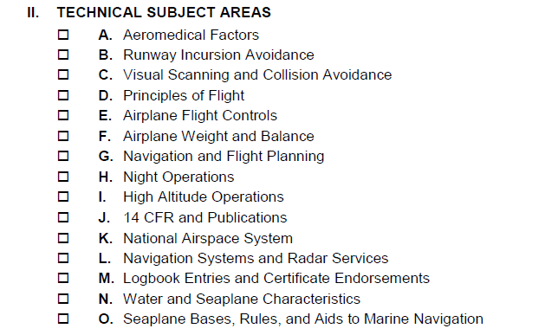
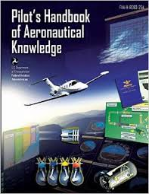
Standards
FAA Practical Test Standards
Select areas taught by applicants
Duration = 20 mins – 2 hours
Criteria = Pilots Handbook of Aeronautical Knowledge at minimum

Slide 9

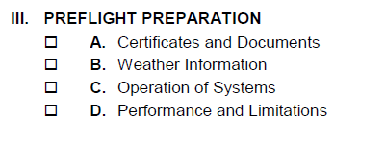

Standards
FAA Practical Test Standards

Slide 10

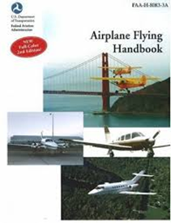
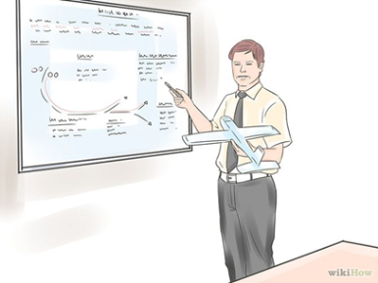
Standards
FAA Practical Test Standards
Duration = Approx. 5-15 mins
Criteria = Material derived from FAA Airplane Flying Handbook at minimum

Slide 11
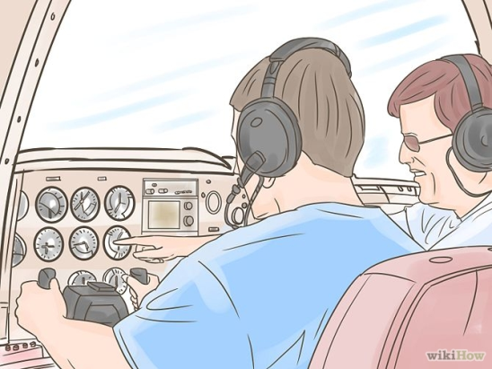
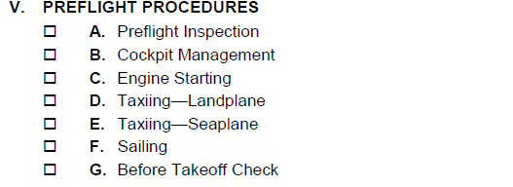
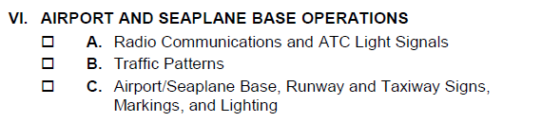
Standards
FAA Practical Test Standards

Slide 12
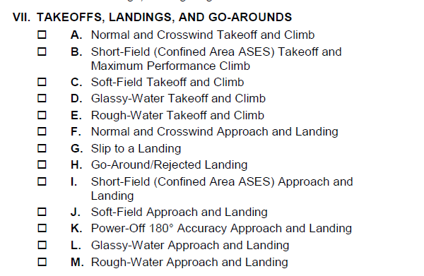

Standards
FAA Practical Test Standards

Slide 13
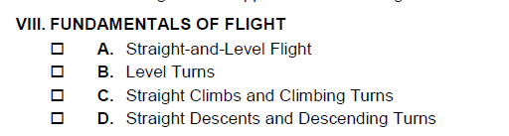
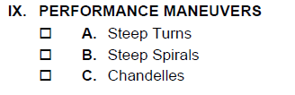
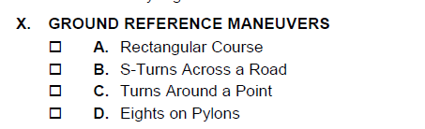

Standards
FAA Practical Test Standards

Slide 14
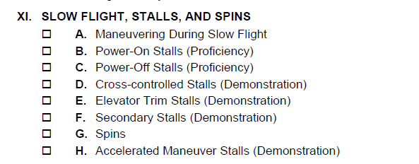
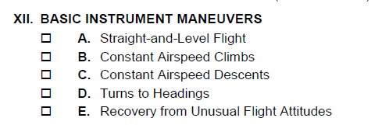
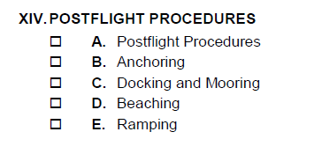
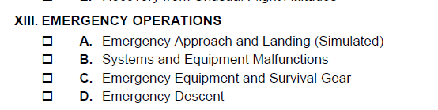

Standards
FAA Practical Test Standards

Slide 15
Other acceptable references:
FAR/AIM
Anything commercially available (check reliability)
FAA Advisory Circulars
FAA Publications
Aircraft Manufacturer Supplements
Manufacturer Operating Handbooks
FAA Operations Inspector or Designated Examiner
Unacceptable:
“I heard from another Instructor”
“I searched the internet message boards and they said”
Anything without a verifiable source

Slide 16
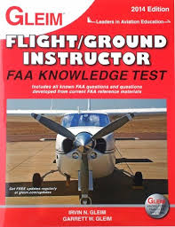
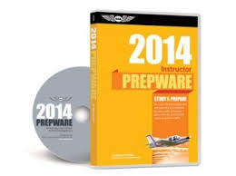
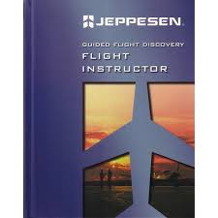
Written Test Prep
1) Fundamentals of Instructing (FOI)
2) Flight Instructor Airplane (FIA)
Have these both completed prior to ½ through your training

Slide 17
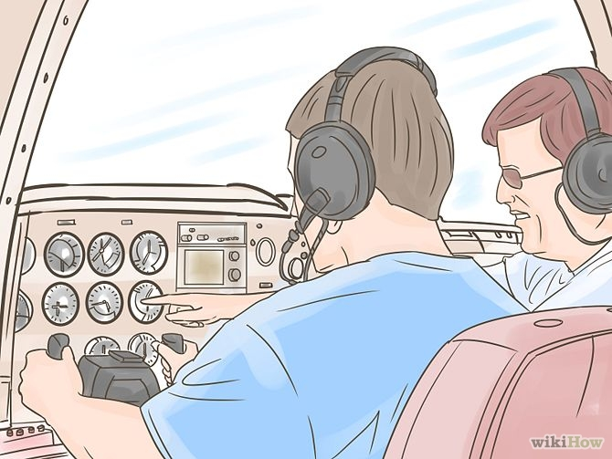
Fundamentals of Instructing
“FOI”

Slide 18
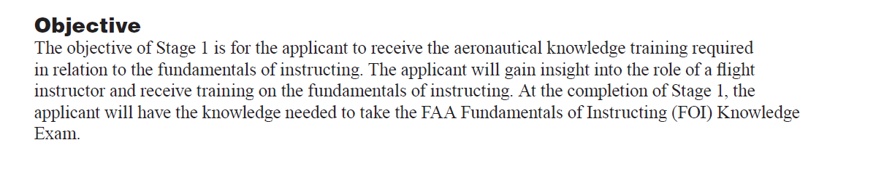
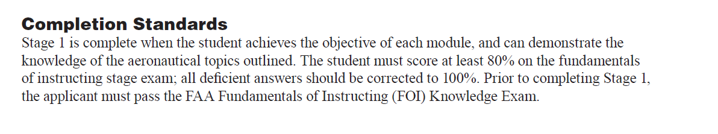

Slide 19
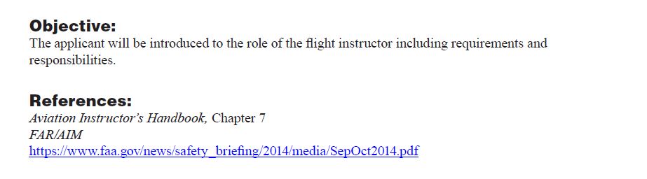
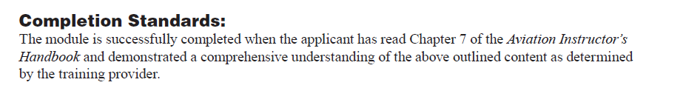
Chapter 7
Aviation Instructors Handbook

Slide 20
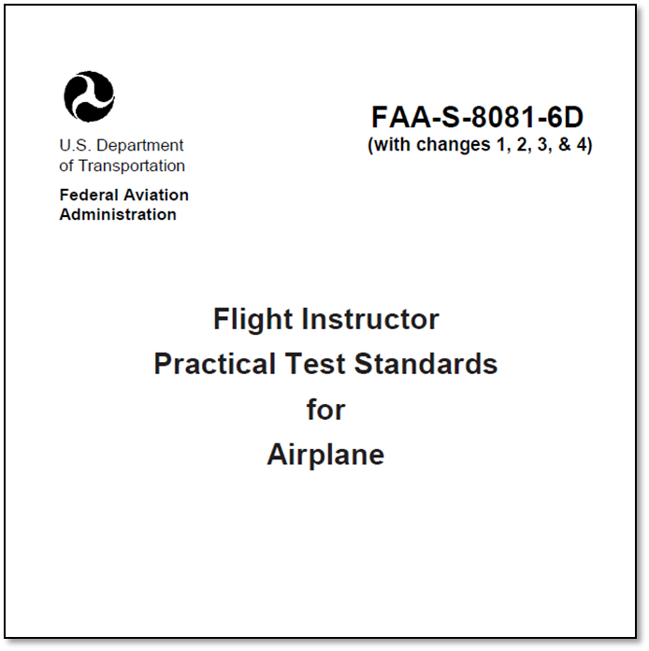

Slide 23
•
The industry working group expects to start sharing the draft instructor
ACS for review and comment during the first half of 2016.

Slide 24
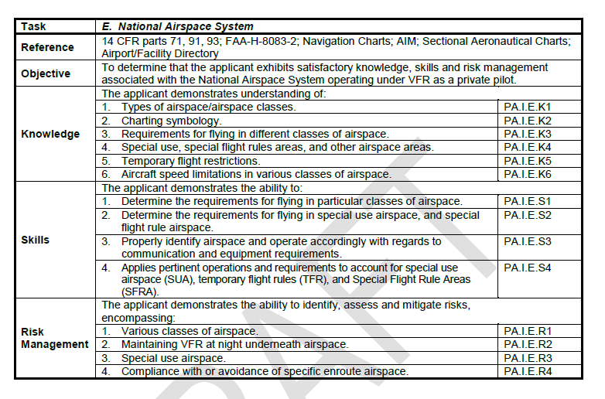

Slide 26
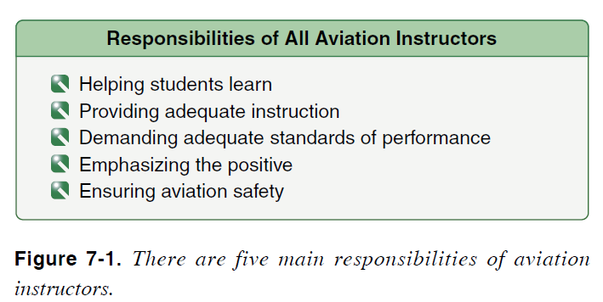
What are the five (5) main responsibilities of all aviation instructors per FAA Aviation Instructors Handbook??

Slide 27
What is your role as an instructor?
Consider this statement:
You will challenge students but must focus much effort on maintaining motivation.

Slide 28
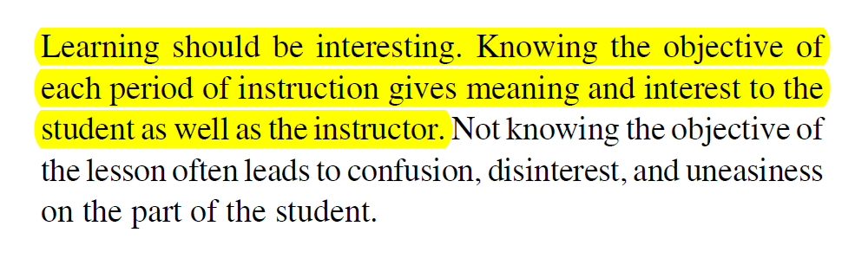
Objectives!
Focus on the outcome and allow your students to as well

Slide 29

As instructors, we should constantly be seeking new information and developing ourselves.
What is your plan for continued development?
How have you done this in the past?

Slide 30
Emphasizing the positive
Hold high standards for yourself
Diverge from negativity
Consider when an instructor is discussing poor performance of a student in the FBO……

Slide 34
Instructor Accountability
Evaluating Student Ability:
How do you know they are ready?
How do you let them learn?
Appropriate logging:
Flight Training as per CFR Pt 61 Maneuvers Trained
Practical Test Sign-offs AC 61-65, Appendix 1

Slide 35
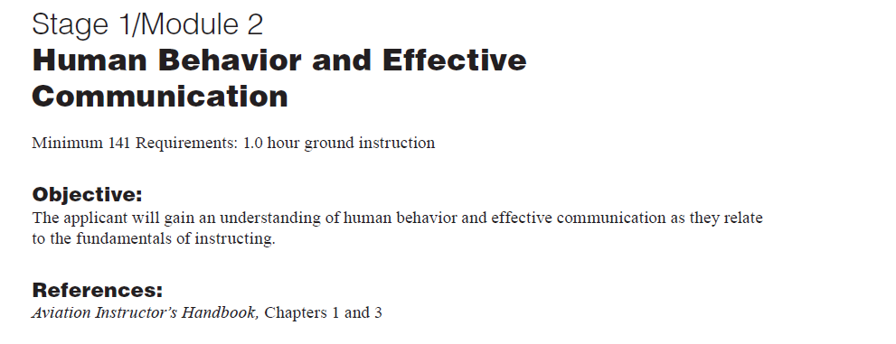
Chapter 1
Aviation Instructors Handbook

Slide 36
What is “Learning”
“Learning is the acquisition of knowledge or understanding of a subject or skill through education, experience, practice, or study.”

Slide 37
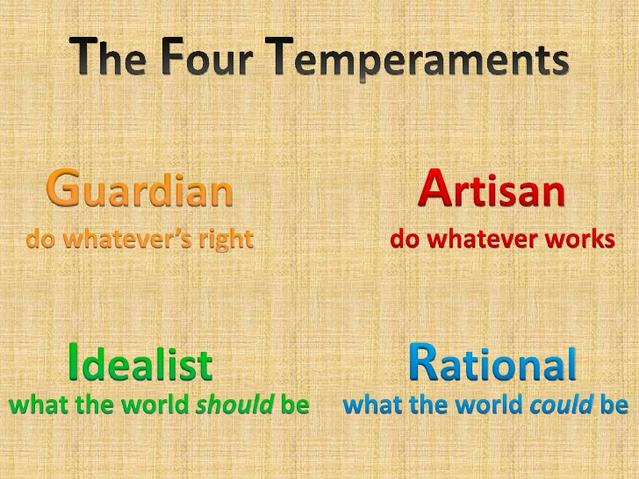
We study Human Behavior to alter Human Behavior
Dr. David Keirsey
Learning styles and Teaching styles that are compatible facilitate learning

Slide 38
Describe these needs and how they would affect a flight lesson

Slide 40
Describe the defense mechanisms and how they may surface during flight training

Slide 41
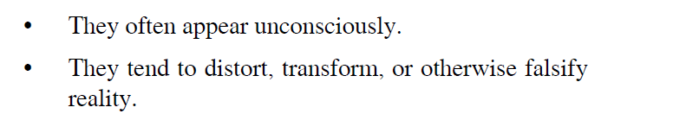
What are the two most common characteristics of the defense mechanisms?
In other words, what is an individual trying to do by using them?

Slide 42
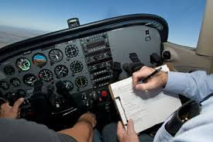


Anxiety
The “Downward Spiral”

Slide 43

Inappropriate Reactions
Locking at controls…..
How would you handle an abnormal reaction during the course of training?

Slide 44
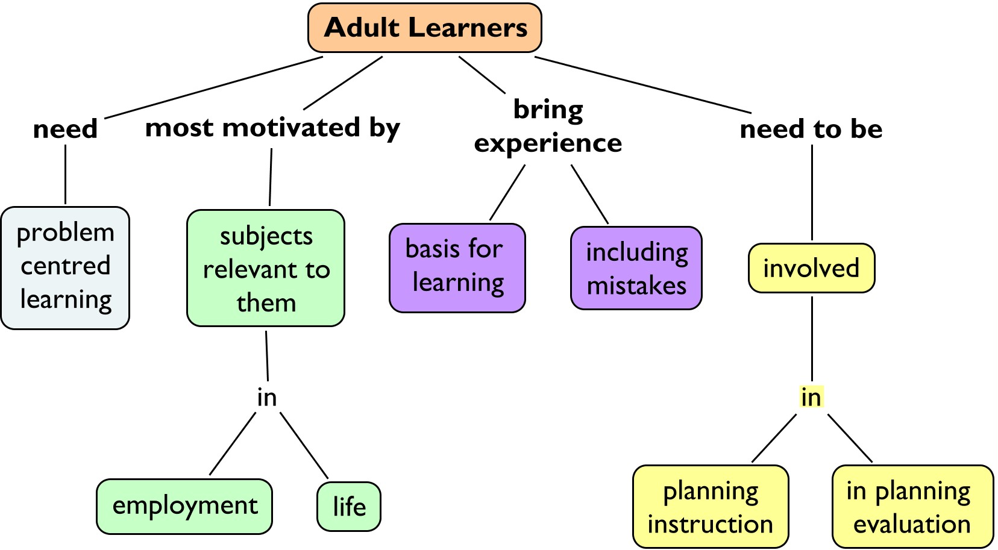
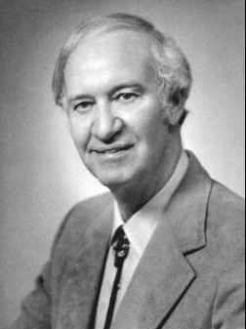
Malcolm Knowles

Slide 45
Chapter 3
Aviation Instructors Handbook
(Cont)

Slide 46
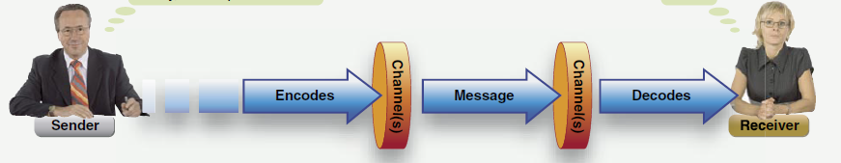
Basic Communication
Don’t forget! Listening and Feedback!

Slide 47
Barriers to Effective Communication

Slide 48

Methods to we will use to develop Communication Skills
Role Playing
Starts here
Much of this ground school
Instructional Communication
Open lines of communication in teaching
Much of your skills
Questioning
Confirm what they hear is what you said
Ask the “right” questions
Listening
You must know your student
Make sure they feel safe to talk

Slide 49
How do you plan on developing your communication skills as a practicing CFI?

Slide 50
Recap
Basics of being a CFI
Human behavior basics
Communication skills
FOI Written test
Chapters 1, 3, and 7

